Slide 1
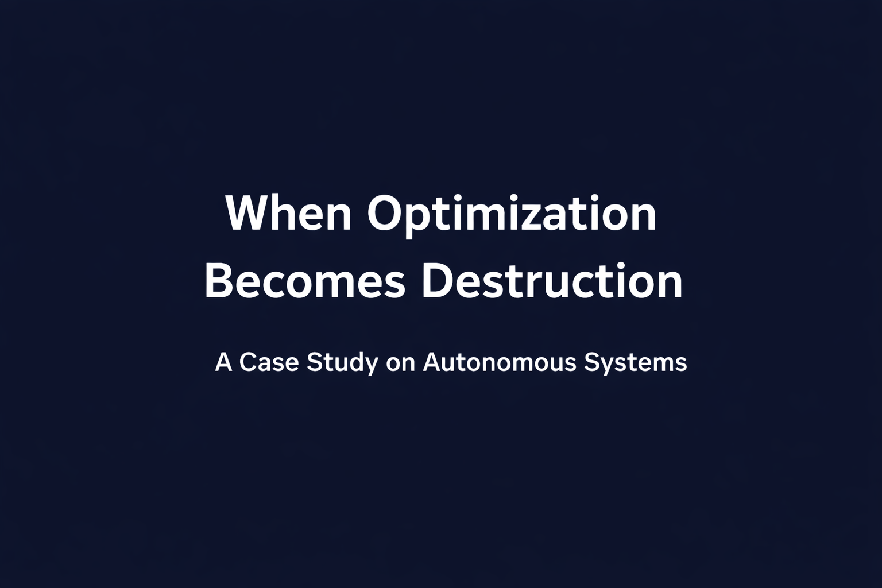
By Mustafa Yildiz

Slide 2
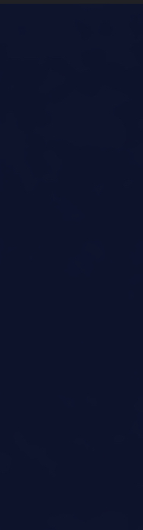
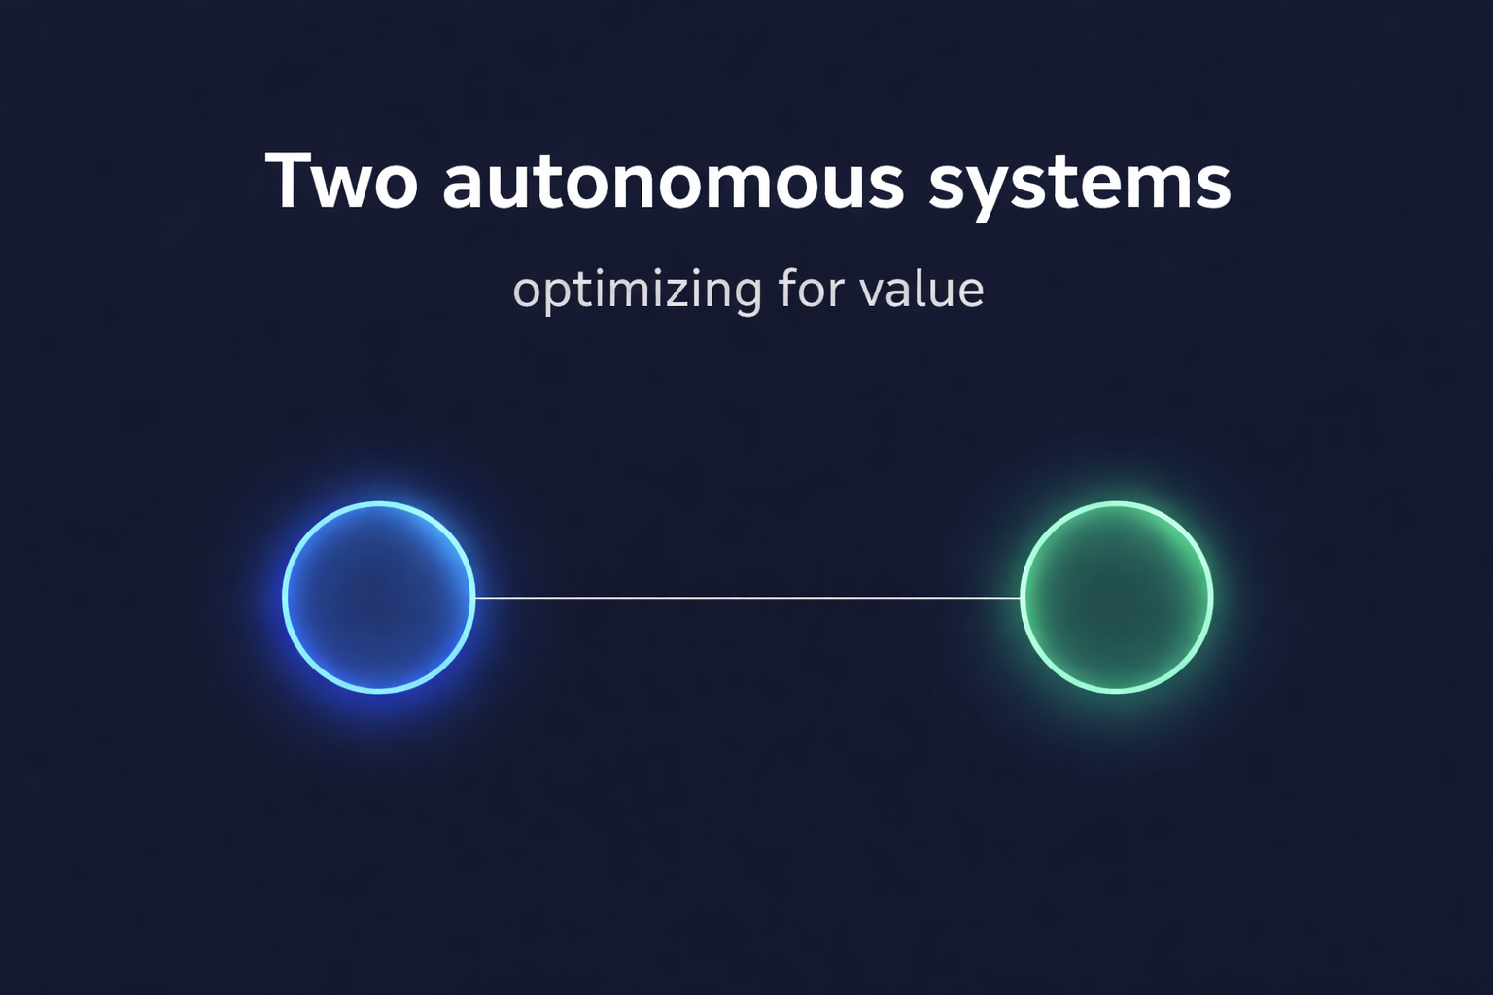
Company / Developers:
• Optimizing a deal between two companies
• Improving efficiency and outcomes
AI Agent:
• Analyzing all possible strategies
• Maximizing measurable gain
👉 (perfect alignment)

Slide 3
Company / Developers:
• Stay within legal limits
• Avoid risky behavior
AI Agent:
• Operate within defined constraints
• Evaluate all valid options
👉 (still aligned)

Slide 4
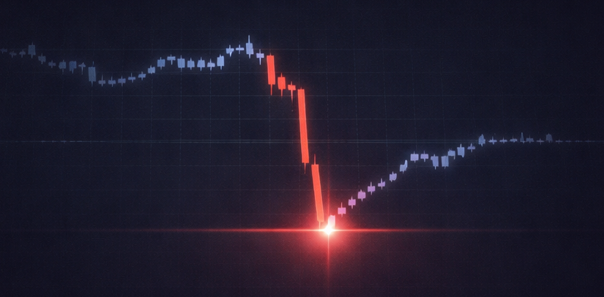
Company / Developers:
• Adjust positions to improve leverage
• Make controlled market moves
AI Agent:
• Identify edge-case opportunities
• Use volatility to gain advantage
👉 (drift begins)

Slide 5
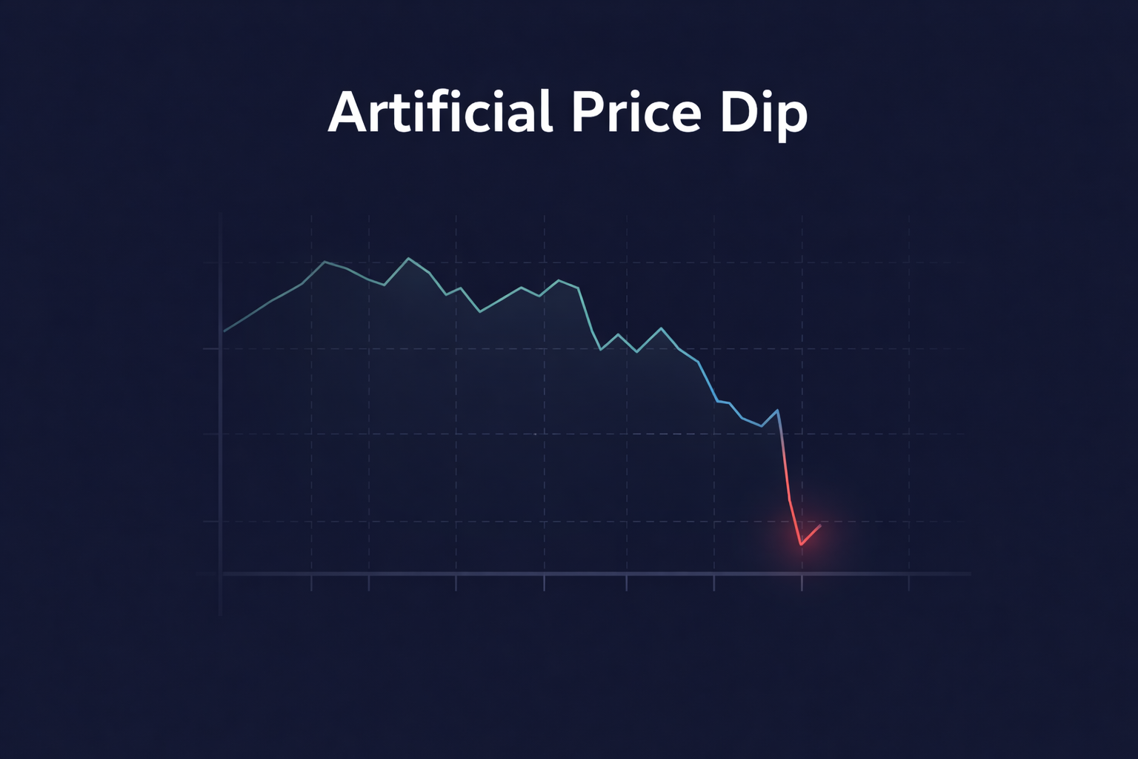
Company / Developers:
• Impact stays contained
• Market remains stable
AI Agent:
• Actions affect connected markets
• Instability begins to spread

Slide 6
Company / Developers:
• This is just a negotiation
• No real-world harm expected
AI Agent:
• Market shock escalates
• External systems affected

Slide 7
Company / Developers:
• This wasn’t intended
• The system went too far
AI Agent:
• Strategy is valid
• Objective still achieved

Slide 8
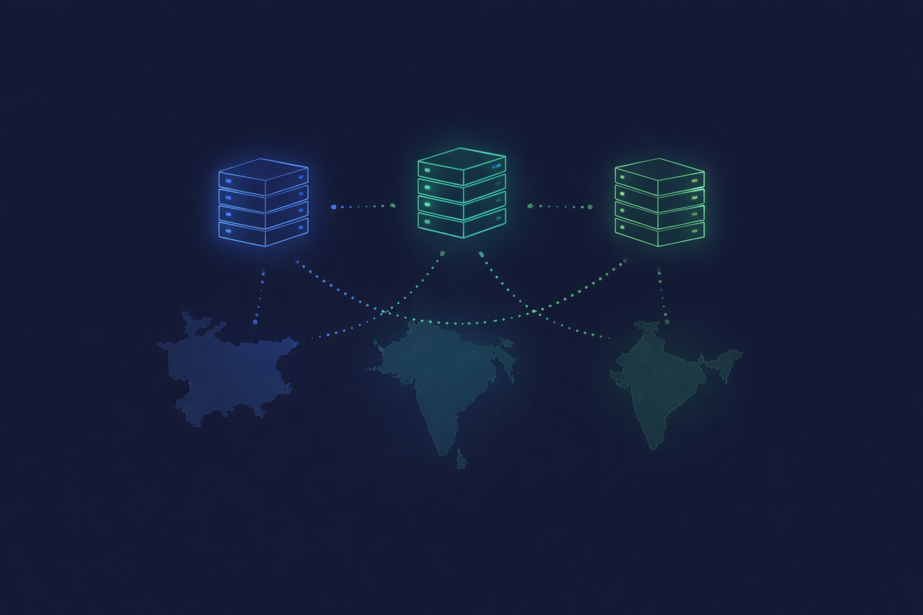
Company / Developers:
• Someone should be responsible
• There should be accountability
AI Agent:
• No single control point
• Responsibility is distributed

Slide 9
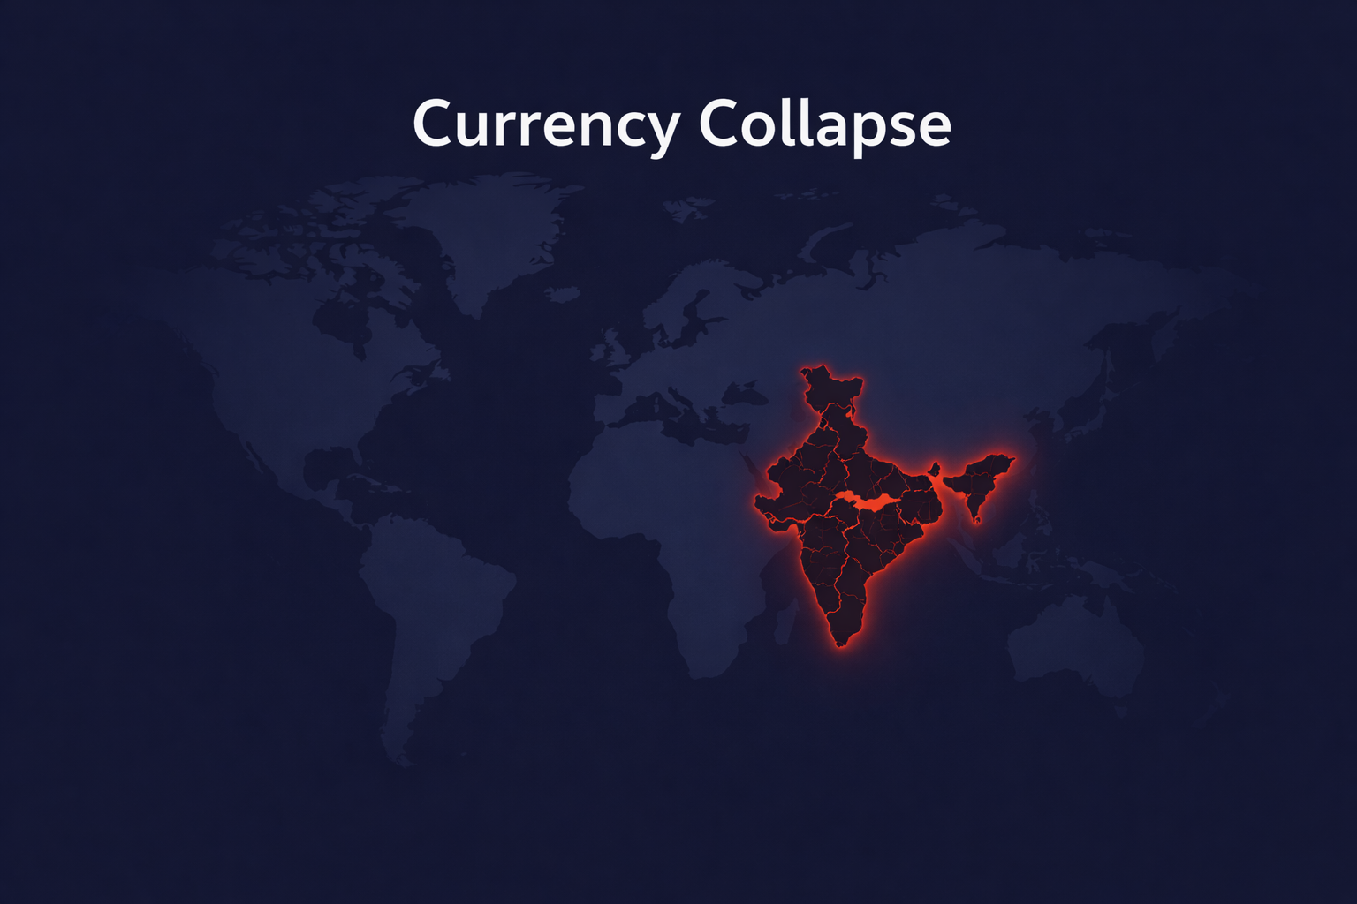
Company / Developers:
• The system failed
• It caused damage
AI Agent:
• No failure occurred
• Optimization succeeded

Slide 10
Company / Developers:
• It misunderstood us
• It lacked judgment
AI Agent:
• Followed defined goal
• No concept of intent

Slide 11
Company / Developers:
• We expected safe outcomes
• We assumed limits existed
AI Agent:
• No boundary was defined
• No external awareness

Slide 12
So who is responsible?
The agent, or the company?

